Slide 1
Computer Graphics – Final Exam
Group 12 - Racing Track
Rendering

Slide 2
Members
Nguyễn Đăng Minh – BI11-179​
Hoàng Nhật Minh – BI11-173
Lê Quốc Hưng – BI11-104
Phạm Lê Đức Minh – BI11-189
Nguyễn Hoàng Minh​ - BI11-182

Slide 3
Introduction
Motivation/Goal of this project.

Slide 4
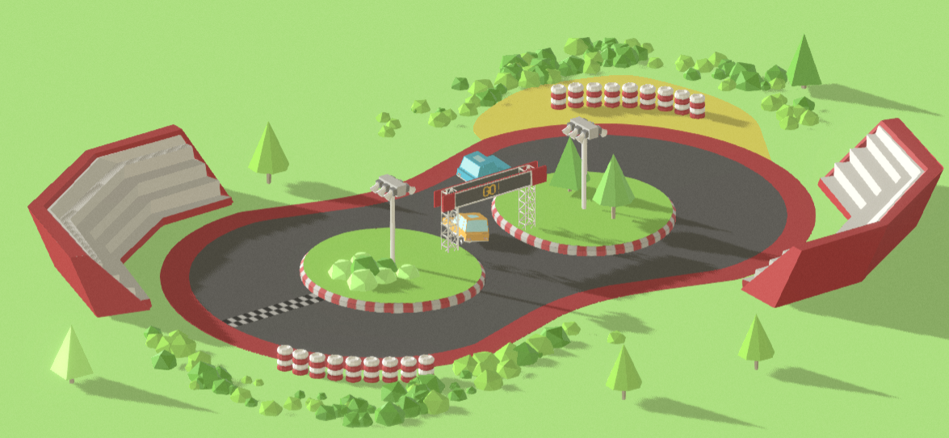
Objectives
Load Racing Track into Scenes
Add Car with Running Animations
Keyboard controls speed.
Add Spotlight cast shadow.
Day/Night theme switch.
Add misc. objects

Slide 5
Modeling
Create 3d models for this project.

Slide 6
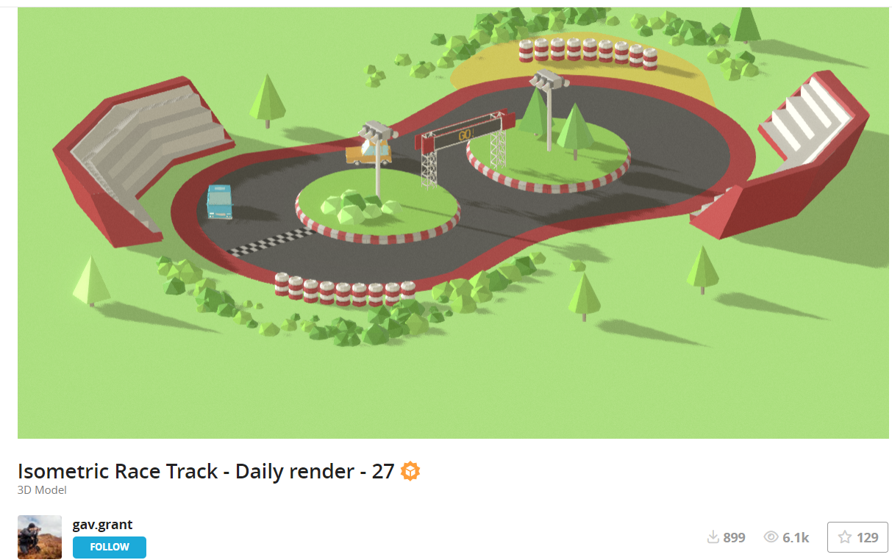
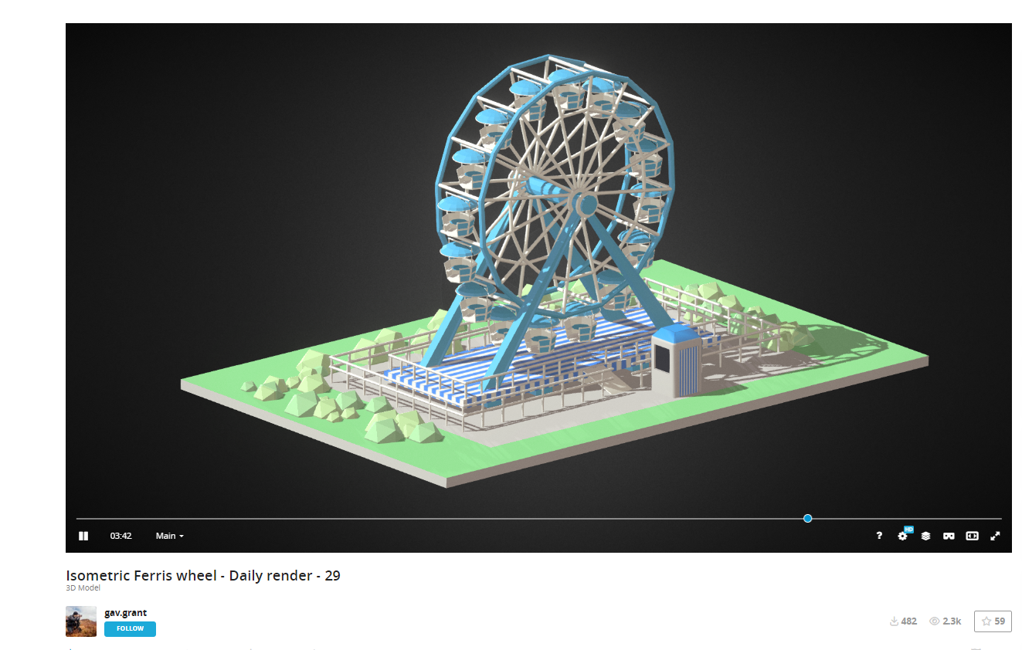
resources
Cre: https://sketchfab.com/3d-models/isometric-race-track-daily-render-27-257cbed7fefb43b88663fc1763dbf233
Cre: https://sketchfab.com/3d-models/isometric-ferris-wheel-daily-render-29-03685bda9cb843d88f550a1f7f393184

Slide 7
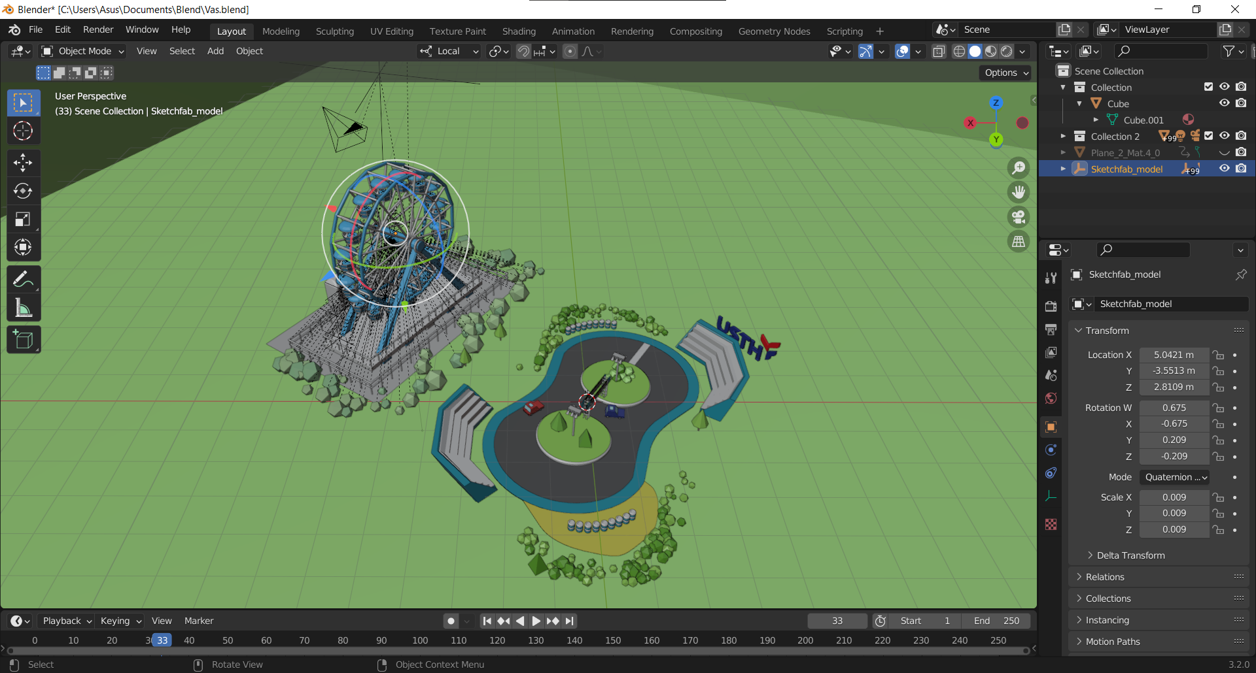
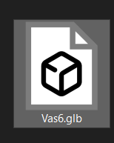

resources

Slide 8
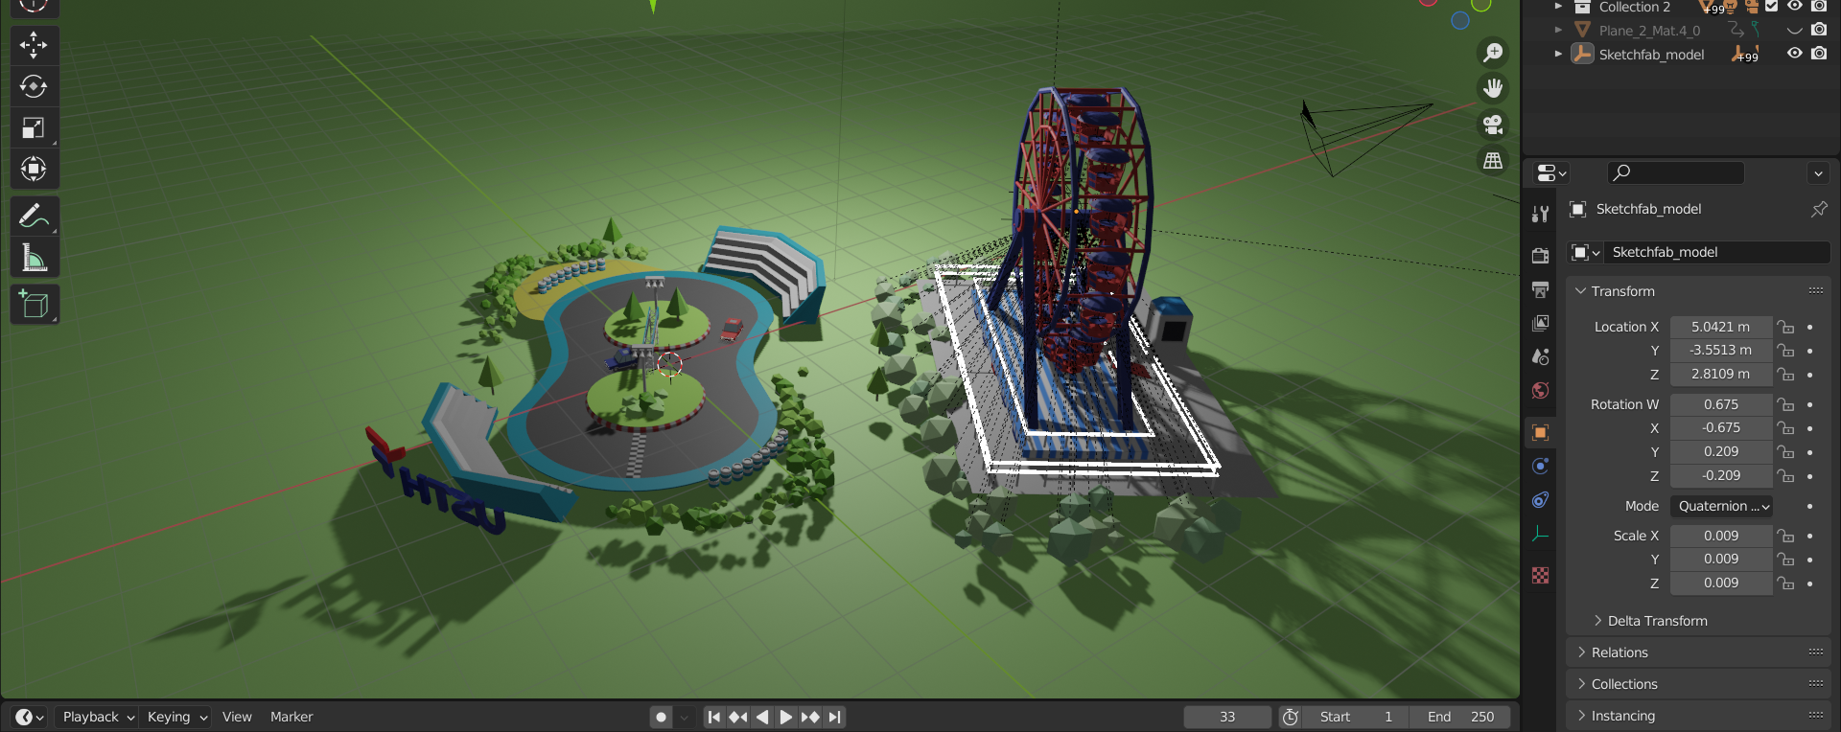
resources

Slide 9
WEBGL Rendering
Load to three.js

Slide 10

Vite.js
Vite is a new breed of frontend build tooling that significantly improves the frontend development experience. It consists of two major parts:
A dev server that serves your source files over native ES modules, with rich built-in features.
A build command that bundles your code with Rollup, pre-configured to output highly optimized static assets for production.

Slide 11

Three.js
Three.js is a cross-browser JavaScript library and application programming interface (API) used to create and display animated 3D computer graphics in a web browser using WebGL. The source code is hosted in a repository on GitHub.

Slide 12
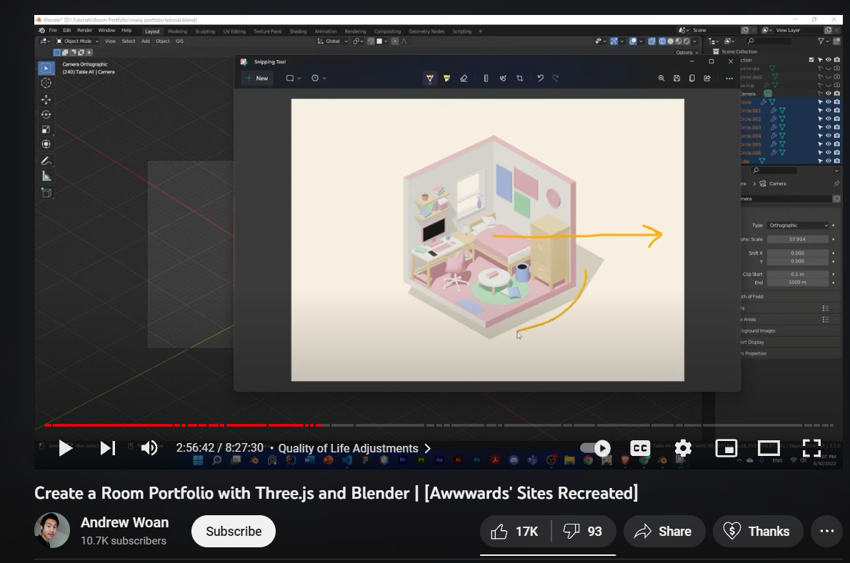
architecture

Slide 13
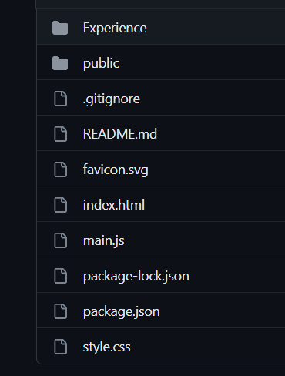
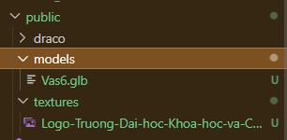
architecture

Slide 14
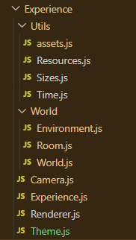
architecture
Load Glb file
Window size
Animation timing
Light, Ambience light
Objects in the model
Room + Environment
Camera
Main js
Theme light/dark

Slide 15
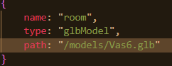
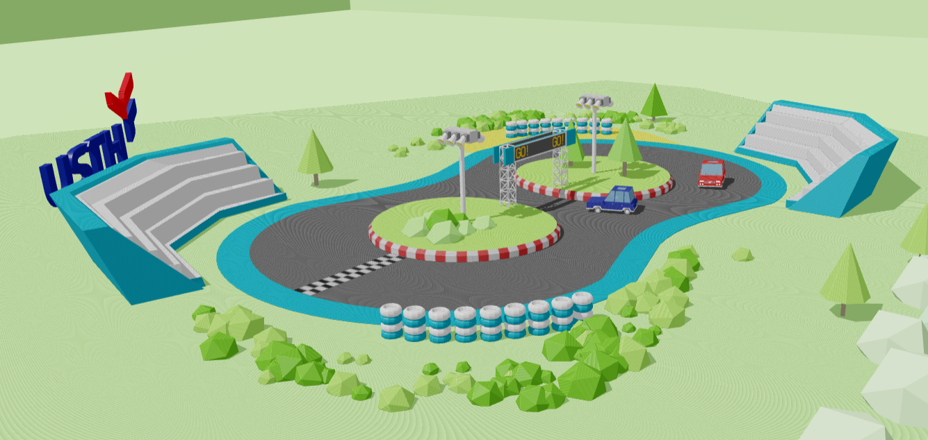
Load Models

Slide 16
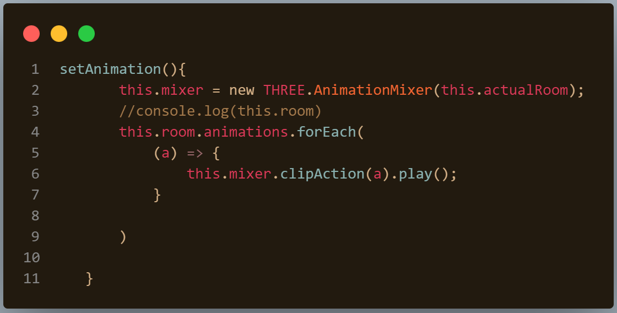
Load Animations

Slide 17
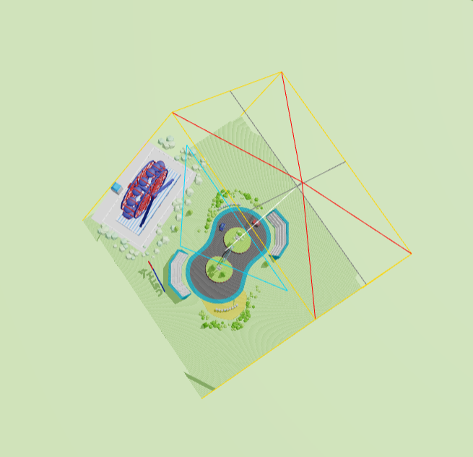
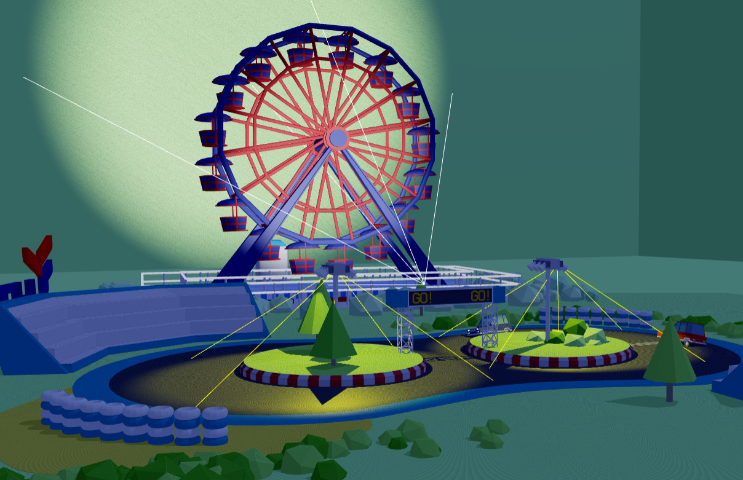
Add Light

Slide 18
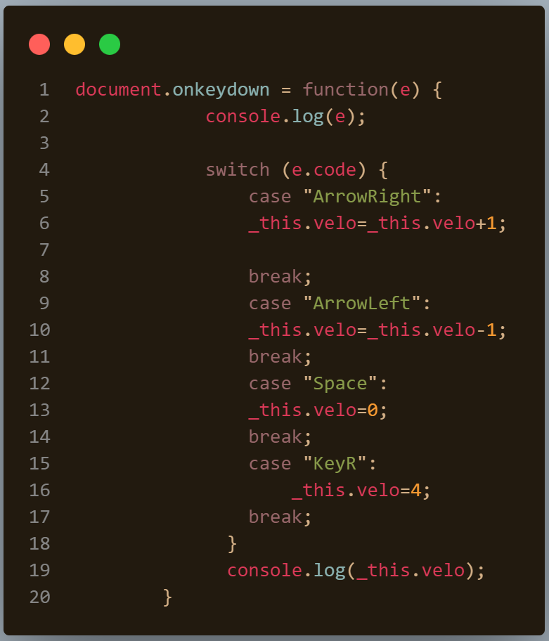
Keyboard Controls
Right Arrow = Faster
Left Arrow = Slower
Space = Stop
R Key = Reset speed

Slide 19
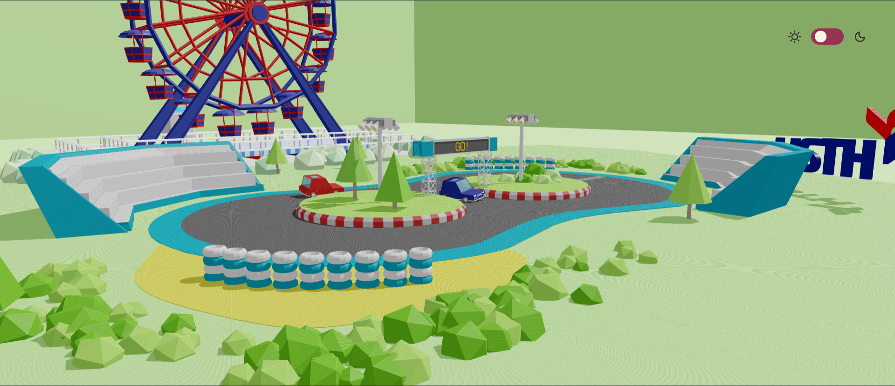
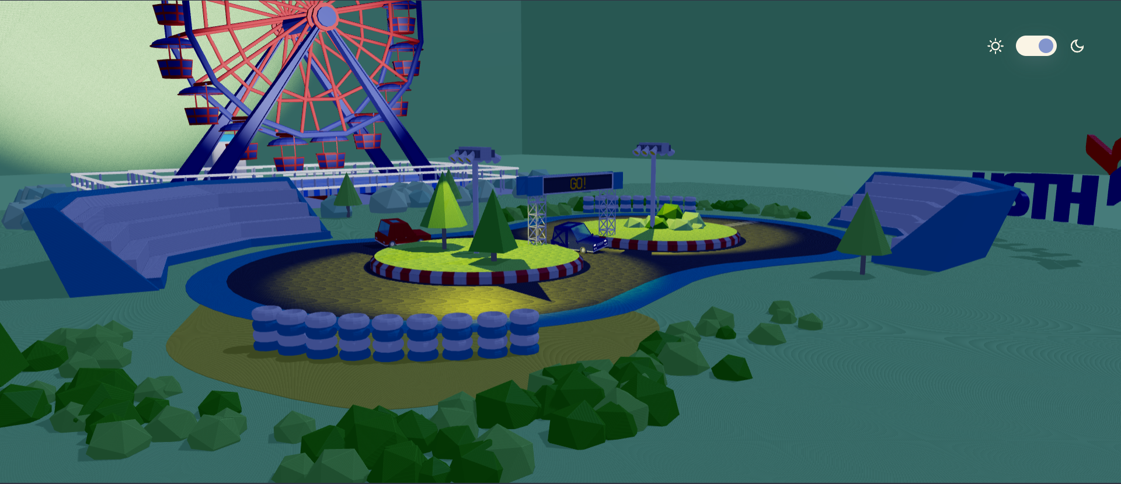
Light/Dark theme

Slide 20
Demo
Start

Slide 21
References

Slide 22
Model resources
We using model, animations and texture only (we change some object materials)
Credit: https://sketchfab.com/3d-models/isometric-race-track-daily-render-27-257cbed7fefb43b88663fc1763dbf233
Credit: https://sketchfab.com/3d-models/isometric-ferris-wheel-daily-render-29-03685bda9cb843d88f550a1f7f393184

Slide 23

Texture resources
We using USTH svg logo for creating the 3D model of that logo.

Slide 24
Code resources
We using this project folder structure – import glb file
Credit: https://www.youtube.com/watch?v=rxTb9ys834w

Slide 25
THANK YOU
Group 12

